Slide 1

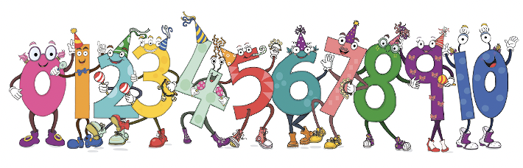
Adio 1 (1-10)

Slide 2
Nodyn i’r ymarferwr:
Pan fydd y sleidiau canlynol yn cael eu chwarae, gellir clicio i weld yr eitemau’n symud a datgelu’r symiau.

Slide 3


2
1 + 1 =
1
1

Slide 4

3
2 + 1 =
2
1

Slide 5
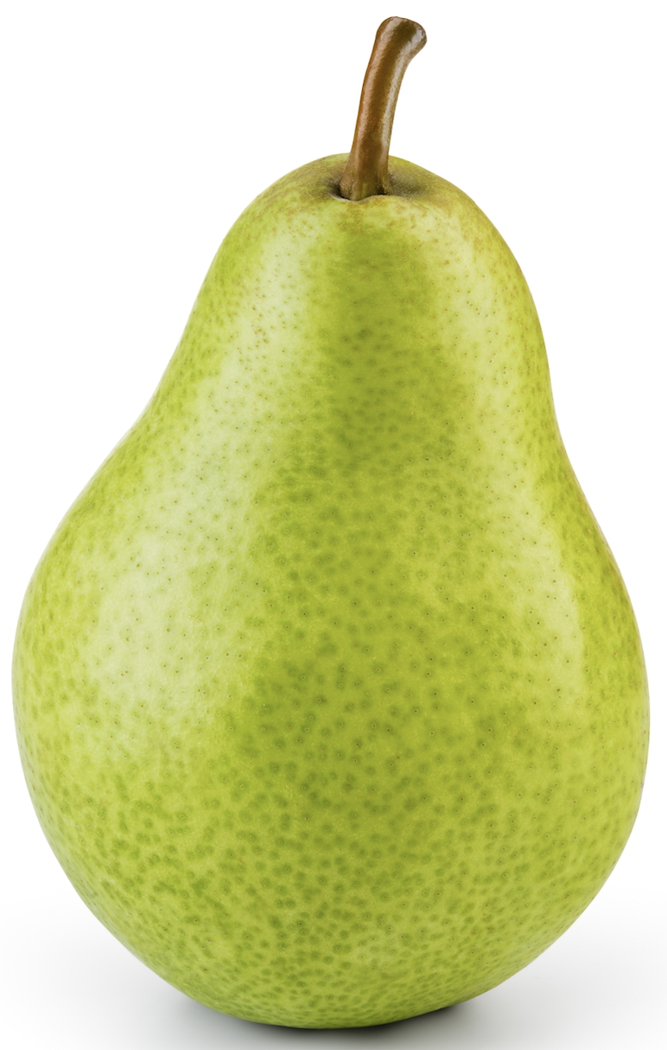
4
3 + 1 =
3
1

Slide 6

5
4 + 1 =
4
1

Slide 7

6
5 + 1 =
5
1

Slide 8

7
6 + 1 =
6
1

Slide 9
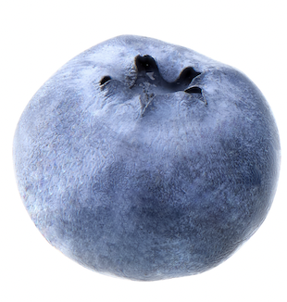
8
7 + 1 =
7
1

Slide 10

9
8 + 1 =
8
1

Slide 11
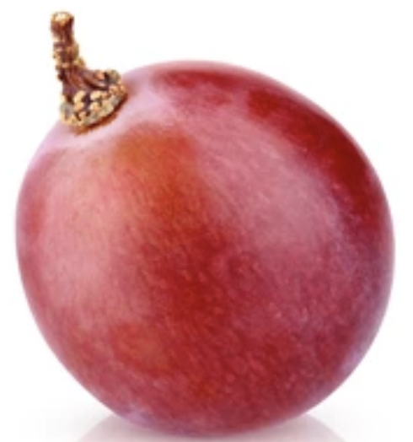
10
9 + 1 =
9
1

Slide 12
Adio 1 (10-20)

Slide 13


11
10 + 1 =
10
1

Slide 14

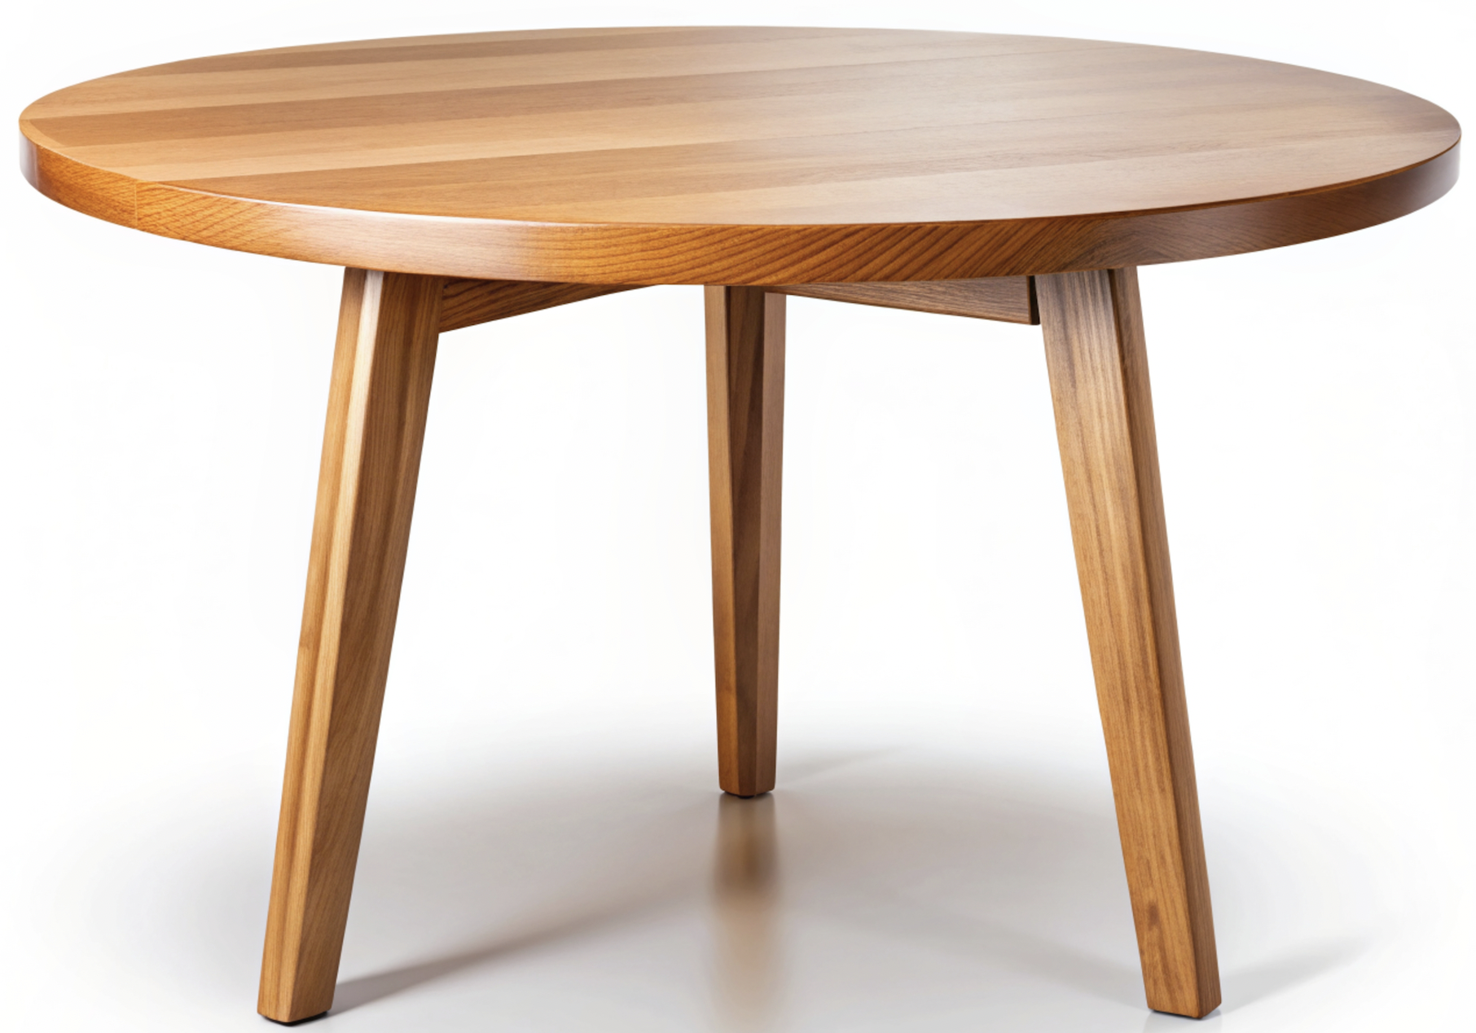
12
11 + 1 =
11
1

Slide 15


13
12 + 1 =
12
1

Slide 16


14
13 + 1 =
13
1

Slide 17


15
14 + 1 =
14
1

Slide 18


16
15 + 1 =
15
1

Slide 19


17
16 + 1 =
16
1

Slide 20
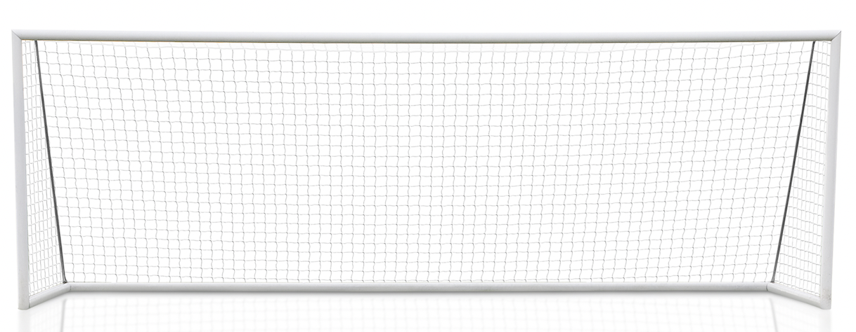

18
17 + 1 =
17
1

Slide 21


19
18 + 1 =
18
1

Slide 22


20
19 + 1 =
19
1

